Slide 1



Summarizing the chapter 5 of N I C H O L A S C . Z A K A S’s book
Summarized By: Marwan Algadi

Slide 2

Chapter 5 Inheritance

Slide 3


topics
01
02
03
04
Prototype Chaining and Object.prototype
Object Inheritance
Constructor Inheritance
Constructor Stealing
05
Accessing Supertype Methods

Slide 4

Introduction
Inheritance is an important concept in object oriented programming. In the classical inheritance, methods from base class get copied into derived class.
In JavaScript, inheritance is supported by using prototype object. Some people call it "Prototypal Inheritance" and some people call it "Behavior Delegation".
Let's see how we can achieve inheritance like functionality in JavaScript using prototype object.

Slide 5
Prototype Chaining and
Object.prototype
When it comes to inheritance, JavaScript only has one construct: objects. Each object has a private property which holds a link to another object called its prototype. That prototype object has a prototype of its own, and so on until an object is reached with null as its prototype. By definition, null has no prototype, and acts as the final link in this prototype chain.
prototype chain: Is an object inherits from its prototype, while that prototype in turn inherits from its prototype, and so on.
All objects, including those you define yourself, automatically inherit from Object

Slide 6
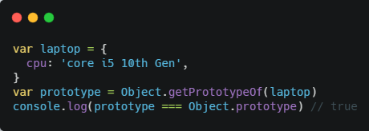
Prototype Chaining and
Object.prototype
all objects inherit from Object.prototype
Any object defined via an object literal has its Prototype set to Object.prototype, defined via an object literal has its Prototype set to Object.prototype, meaning that it inherits properties from Object.prototype.
Object.getPrototypeOf() method returns the prototype.
This’s default behavior, that laptop has equal prototype to Object.prototype.

Slide 7
Prototype Chaining and
Object.prototype
Methods Inherited from Object.prototype
Lots of methods used in this chapter till now are defined on Object.prototype and are therefore inherited by all other Objects, methods like:
hasOwnProperty(): Determines whether an own property with the given name exists
propertyIsEnumerable(): Determines whether an own property is enumerable
isPrototypeOf(): Determines whether the object is the prototype of another
valueOf(): Returns the value representation of the object
toString(): Returns a string representation of the object

Slide 8

Prototype Chaining and
Object.prototype
valueOf()
Object.prototype.valueOf()
method returns the primitive value of the specified object,
The valueOf() method gets called whenever an operator is used on an object.
When the greater-than operator (>) is used, the valueOf() method is called on both objects before the comparison is performed.
Note that You can always define your own valueOf()
method

Slide 9
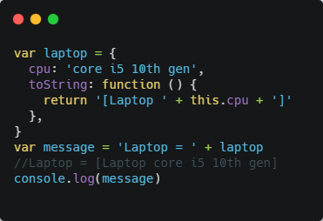
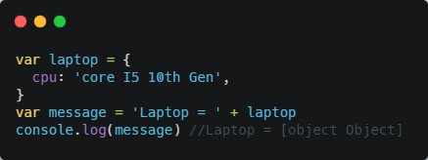
Prototype Chaining and
Object.prototype
toString()
method returns a string representing the object, The toString() method is called as a fallback whenever valueOf() returns a reference value instead of a primitive value.
You can also define your own toString method (also any other prototype method) that returns clearer result.
This code constructs the string by combining “Laptop = " with laptop.

Slide 10
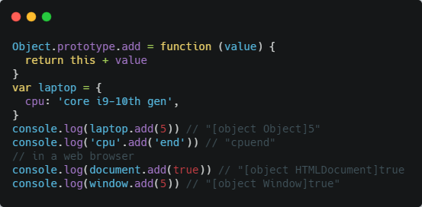
Prototype Chaining and Object.prototype
Modifying Object.prototype
We knew that all objects inherit from Object.prototype by default, so changes to Object.prototype affect all objects.
But that’s a very dangerous situation, and you shouldn’t NEVER modify object prototypes.
Adding Object.prototype.add() causes all objects to have an add() method
Another aspect of this problem involves adding enumerable properties
to Object.prototype. In this example, Object.prototype.add()
is an enumerable property, which means it will show up when you use a
for-in loop

Slide 11
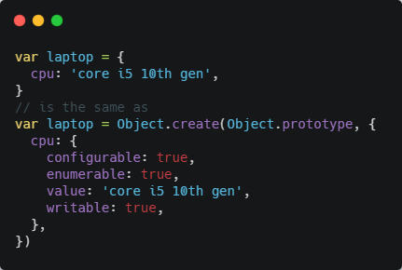
Object Inheritance
The simplest type of inheritance is between objects. All you have to do is specify what object should be the new object’s Prototype. Object literals have Object.prototype set as their Prototype implicitly, but you can also explicitly specify Prototype with the Object.create() method.
The Object.create() method creates a new object, using an existing object as the prototype of the newly created object.
The first declaration uses an object literal to define an object
The second declaration takes the same steps but does so explicitly
using
Object.create().
The resulting book object from each declaration
behaves the exact same way

Slide 12
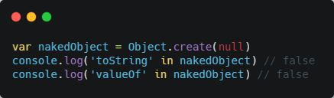
Object Inheritance
You can also create objects with a null Prototype via Object.create(),
like:
The nakedObject in this example is an object with no prototype chain.
That means built-in methods such as toString() and valueOf() aren’t present on the object.

Slide 13
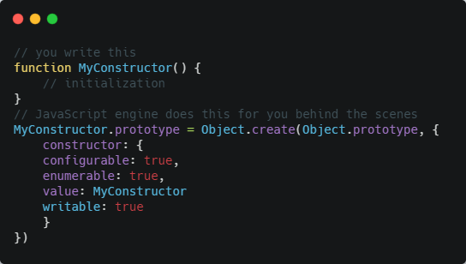
Constructor Inheritance
The Object inheritance in JavaScript is also the basis of constructor inheritance
the JavaScript engine does the following for you:
So without doing anything extra, this code sets the constructor’s prototype property to an object that inherits from Object.prototype, which means any instances of MyConstructor also inherit from Object.prototype.

Slide 14
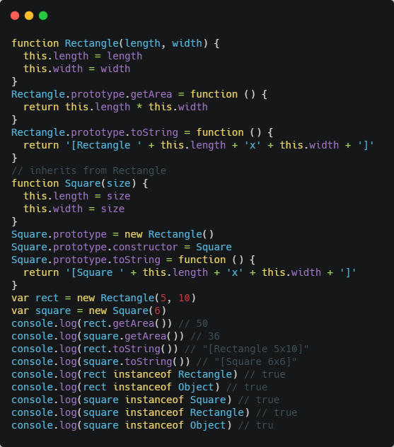
Constructor Inheritance
In this code, there are two constructors: Rectangle u and Square.
The Square constructor has its prototype property overwritten with an instance of Rectangle. No arguments are passed into Rectangle at this point because they don’t need to be used, After that, rect is created as an instance of Rectangle, and square is created as an instance of Square. Both objects have the getArea() method because it is inherited from Rectangle.prototype. The square variable is considered an instance of Square as well as Rectangle and Object because instanceof uses the prototype chain to determine the object type.

Slide 15
Constructor Stealing
Constructor Stealing is to call the Shape constructor from within the Rectangle constructor.
The apply() and call() methods can be used to execute a constructor on the newly created object.
In effect, you’re stealing the supertype constructor for your own object.

Slide 16
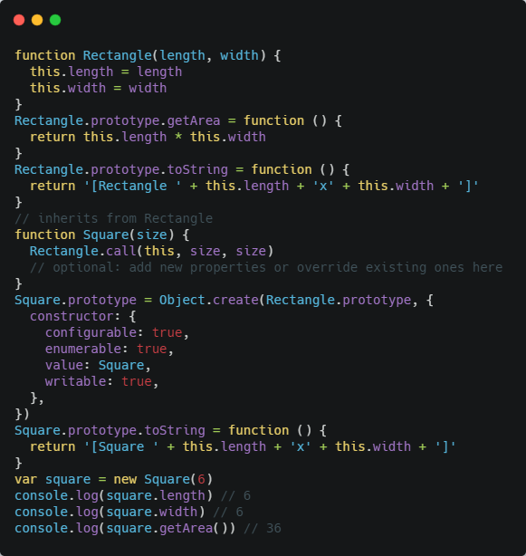
Constructor Stealing
The u Square constructor calls the Rectangle constructor and passes in this as well as size two times.
doing so creates the length and width
properties on the new object and makes each equal to size.
You can add new properties or override existing ones after applying the type constructor.
This two-step process is useful when you need to accomplish inheritance between custom types.

Slide 17
Accessing Supertype Methods
In the previous example, the Square type has its own toString() method that shadows toString() on the prototype.
It is fairly common to override supertype methods with new functionality in the subtype.
In other languages, you might be able to say super.toString(), but JavaScript doesn’t have anything similar. Instead, you can directly access the method on the supertype’s prototype and use either call() or apply() to execute the method on the subtype object.

Slide 18
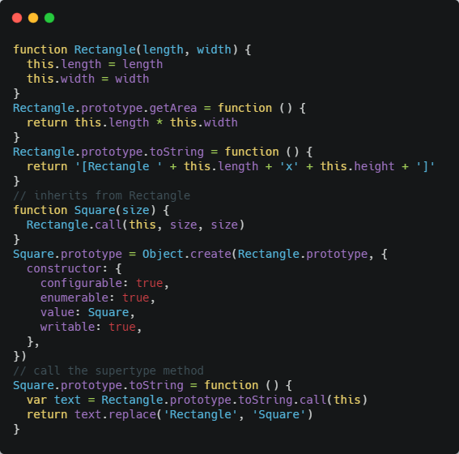
Accessing Supertype Methods
For example:
In this piece of the code, Square.prototype.toString() calls
Rectangle.prototype.toString() by using call(). The method just needs
to replace "Rectangle" with "Square" before returning the resulting text.
This approach may seem a bit verbose for such a simple operation, but it is the only way to access a supertype’s method.

Slide 19
Alternative resources
The-principles-of-object-oriented-JavaScript (by: Nicholasc. Zakas)
https://developer.mozilla.org (MDN Web Docs)
https://www.w3schools.com
https://www.tutorialsteacher.com

Slide 20
—Frank Ocean
Quote:
“Work hard in silence, let your success be your noise.”

Slide 21

To meet again in chapter 6

